Slide 1
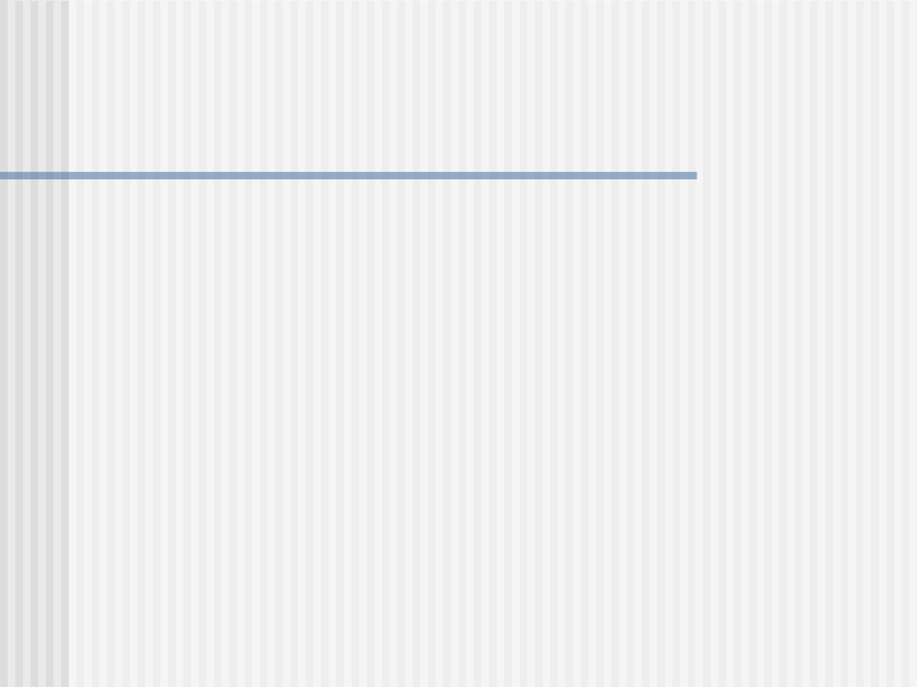
State Diagrams
  A state machine visualizes an object of a class as an isolated entity.
  It describes how the object communicates with the rest of the world by detecting events and responding to them.
  State diagrams model the dynamic aspects of a system and treats a particular object in an isolated manner.
  The state machine describes all the possible states that an object can have during its life cycle and how the object responds to an event when it is in a particular state.

Slide 2
What are state machines?
  A state machine is a graph of states and transitions.
  Usually, a state machine is attached to a class and it describes the response of the object of the class to events that it receives.

Slide 3
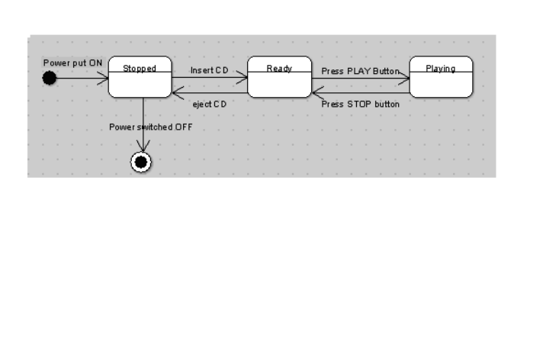
States of a CD Player

Slide 4


State Notations
Stopped
Stopped

Slide 5
Event
  Any noteworthy occurrence which can have consequences is an event.
  5 types of events:
  1)Time Event- The time is calculated either as absolute time or the passage of relative amount of time.
  E.g.1.At a college Computer Science laboratory a anti-virus system is programmed to be invoked to scan the computers at 12:30 p.m. everyday.
  12:30 p.m. is the absolute time.
  The event is the invocation of the anti-virus software and the transition of the states of each computer in the laboratory is from NotScanned to UnderScanning.

Slide 6
Event
  E.g.2.Settings on each machine are such that it will go into locked mode if it is idle for 2 minutes.
  So the passage of time of 2 minutes in the Idle state transforms the machine to the locked state.
  2)A Guard Condition becoming true- This is shown as a guard condition on a state transition. When the transition is set to occur, the condition is tested. If it is true then the state changes.

Slide 7
Event
  3)Change Event- It is evaluated continuously till it becomes true and finally when it becomes true the transition fires.
  4)Call Event- It is the receipt of an explicit synchronous request among objects that wait for a response.
  Suppose an object o1 sends a message to o2. o2 processes the call event either by transitioning to a new state or failing to make a transition.
  Either way, the control returns to the calling object.
  5)Signal Event- Here, the calling object sends asynchronous messages to receiving objects.
  The sender does not wait for the receivers to process the messages and return.
  It continues its own work independently.

Slide 8
Event
  It is not necessary for an event to be attached to a state transition.
  The state of an object can change when its internal actions are executed.
  Thus, the performance of all actions in a state transitions the object to a new state.

Slide 9
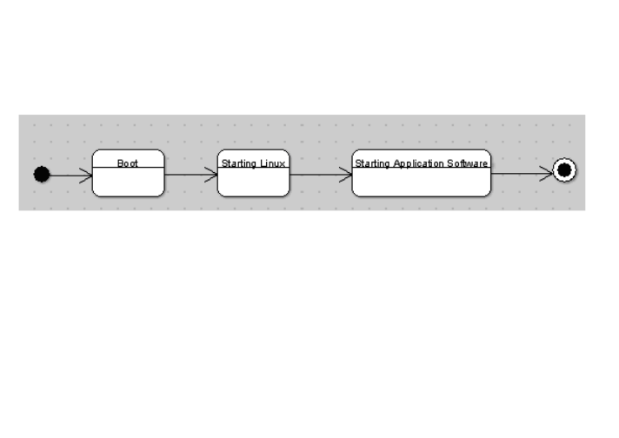
Event

Slide 10
States and Transitions
  A state when represented using a rectangular box with rounded edges can have three compartments.
  The first compartment:name of the state. e.g. Stopped, Ready etc.
  The second compartment is optional. It indicates behaviour in response to events. There are 3 reserved event names in UML. They are
1) entry-It indicates actions to be done upon entering into a state.
2) do- It indicates actions to be done while in the state.
3) exit-It indicates actions to be done on exit from a state.

Slide 11
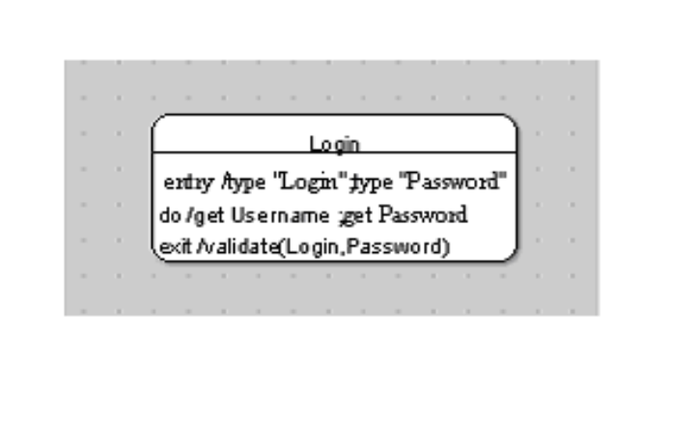
States and Transitions

Slide 12
States and Transitions
  A modeler can define his own event. The event name has to be something other than entry, exit and do. The syntax for the activity compartment is eventname argument-list '/' action-expression.
  The third compartment is also an optional compartment depicting internal transitions.
  An internal transition is one which has a source state but no target state.
  The active state does not change as a result of its firing.

Slide 13
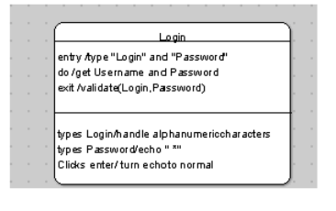
States and Transitions

Slide 14
Formal Syntax for Specifying a State Transition
  Event Signature '[' guard condition ']' '/' action expression send-clause
  Event Signature- It consists of the event name and parameters.
  eventname'('list of parameters separated by commas')‘
  Guard condition- It is tested at the time the event fires. This transition takes place only if the guard condition is true. If both event signature and guard condition are present, then the event must occur AND the guard condition must be true for the transition to take place.

Slide 15
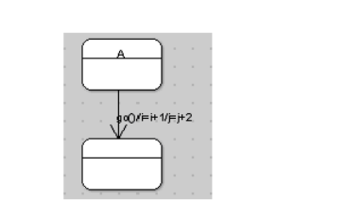
Formal Syntax
  Action Expression- It is an expression to be executed when the transition fires. In case of multiple actions, they are fired from left to right and they are separated by a forward slash '/' on the diagram.

Slide 16
Formal Syntax
  When go() event is triggered the state is changed from A to B.
  At that time i gets incremented by 1 and j by 2. i=i+1 and j=j+2 are the action expressions.

Slide 17
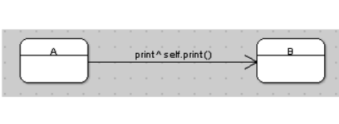
Formal Syntax
  Send-Clause- It is a special syntax for sending a message during a transition from one state to another.

Slide 18
Formal Syntax
  When 'print' event occurs the object sends a message to itself to execute its own print function. Syntax of the send clause is :
  '^‘destination-expression.destinationmessagename'('arguments')'
  E.g. Nopaper ^ indicator.light(red)
  A transition may have more than 1 send-clause each with its own ^ delimiter.
  The sequence of action-expression statements, operations and send-clauses determines the order of the execution.

Slide 19
Substates
  Internally, a state can have substates. There are 2 types of substates and-substate and or-substate.
  OR-substate- A state can have multiple substates but only 1 substate may be true at a given time.
  AND-substate- The current state can have concurrent substates. Several of them may be true in parallel. And-substates can be used while modeling the states of concurrent threads.

Slide 20
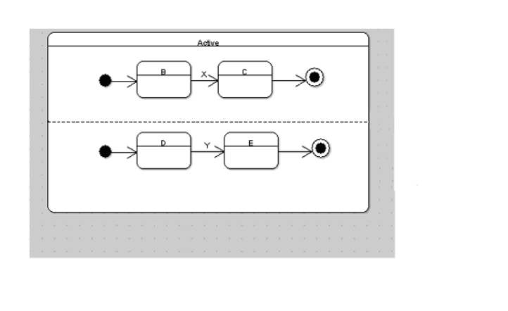
Substates

Slide 21
Substates
  There is a superstate called Active. When the object enters this state, it enters the states B and D at the same time.
  Suppose an event X causes the transition to substate C from substate B. It is independent and has no effect on the second nested substate.
  However, if the object transitions from Active superstate to some superstate, say, Passive, a transition from all concurrent substates occurs.
  The object can either be in substate B or C and D or E at any time it is in Active state.
  So states B and C are or- substates and so are states D and E.

Slide 22
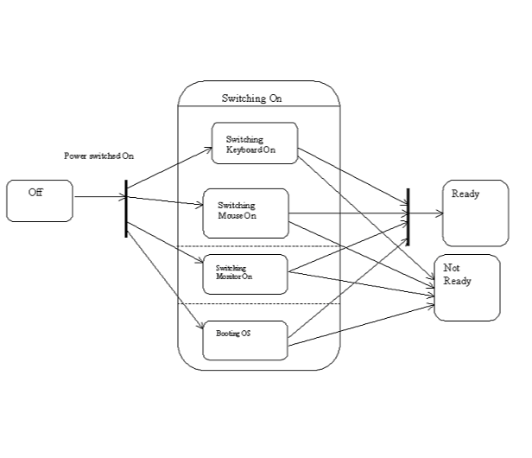
Modeling Complex transitions

Slide 23
Modeling Complex transitions
  A complex transition can have multiple source and/or destinations states.
  UML provides for the use of a thick vertical bar from which multiple arrows can emanate which depict transitions to states occurring concurrently or to which many arrows can end depicting synchronization of multiple states into one state.
  E.g. Initially a computer is Off. It is considered to be switching On when keyboard, mouse and monitor are being switched ON and it is booting into an Operating System.
  It is considered Ready to Use if all the three activities have completed successfully.
  If any one of those activities has failed, the Computer is in the Not Ready state.

Slide 24
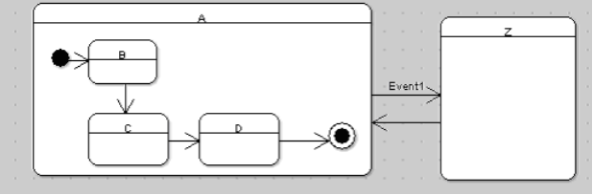
The History Indicator (Shallow & Deep History)

Slide 25
The History Indicator (Shallow & Deep History)
  Consider a state "A" of an object.
  It has substates B,C and D.
  Events (which are not indicated in the figure) transform the object in state "A" to substates C and D, B being the initial substate.
  The arrival of an event "Event1" changes the state of the object from A to Z.
  Suppose an object in state A is in substate "C".
  When it is in this substate, event "Event1" occurs.
  The state will be transformed to state Z.
  When the action in state Z is over, the object must transform to state A but to substate C and not the initial state B.
  How to model this occurrence?

Slide 26
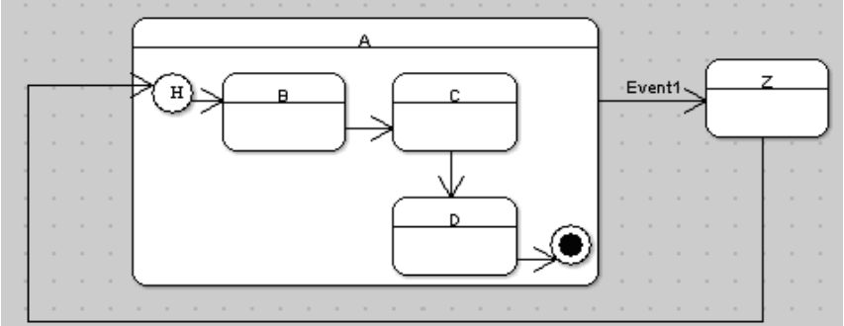
The History Indicator (Shallow & Deep History)

Slide 27
The History Indicator (Shallow & Deep History)
  Use history indicator.
  It allows the state to remember the last substate that it was in before the occurrence of the event changed the state.
  The symbol H is used even before the initial substate, in our case before B.

Slide 28
The History Indicator (Shallow & Deep History)
  The first time state A is entered, it has no history.
  The moment state A is entered the first time, substate B is entered.
  Suppose the substate changes to C.
  At this moment event "Event1" occurs and the state of the object is transformed to Z.
  After the action in state Z is over, the transition returns to the history indicator of the state "A".
  Control now passes to the substate C rather than substate B because there is a history to the nested state machine.

Slide 29
The History Indicator (Shallow & Deep History)
  Symbol H indicates "shallow" history that remembers only the history of the immediate nested state machine.
  If there are multiple layers of nesting UML provides for another symbol H* to indicate "deep history".
  Deep history remembers down to the innermost substate at any depth.
  If the nesting is at one level only as in the previous example, shallow and deep history indicators are equivalent.

Slide 30
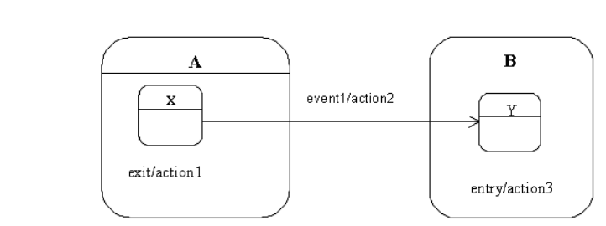
The Junction state

Slide 31
The Junction state
  There are 2 composite states A and B containing substates X and Y respectively.
  The occurrence of event1 triggers the transition of substate X in state A to substate Y in state B.
  When event1 occurs, action1 will always occur first followed by action2 and action3.
  How to change the order of the actions? Use junction state!
  A junction state is denoted by a circle.

Slide 32
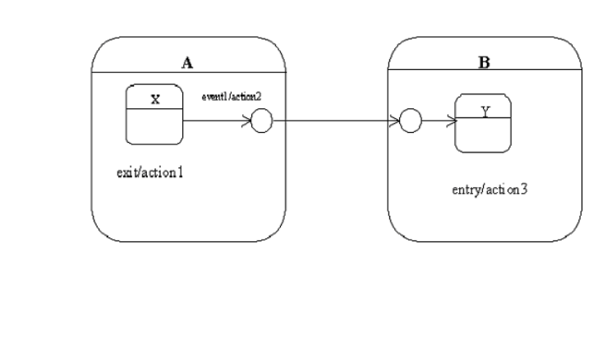
The Junction state

Slide 33
The Junction state
  When the event event1 occurs the sequence of actions are action2, action1 and action3.
  A junction builds a single transition from multiple transition segments.
  However, among the segments, only the first segment can have an event trigger.

Slide 34
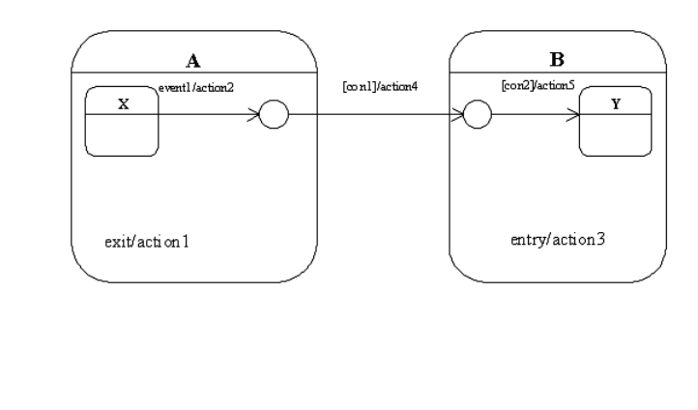
The Junction state

Slide 35
The Junction state
  When the substate X is active, the occurrence of event1 triggers the actions 2, 1, 4, 3 and 5.
  Actions 4 and 5 cannot have separate event triggers although they may have guard conditions.
  If actions 4 and 5 have guard conditions, the occurrence of event1 and the satisfying of all guard conditions namely con1 and con2 will transform the object from substate X in state A to substate Y in state B also causing actions 2, 1, 4, 3 and 5 to execute in the process.

Slide 36
The Junction state
  A transition cannot stop at a junction state.
  It must compulsorily reach a normal state.
  The firing of an incoming transition arriving at a junction state compels the firing of a transition outgoing from the junction state immediately with the execution of any attached action.
  The execution of incoming and outgoing transition is a single atomic event in the sense that they cannot be interrupted by any event or action.

Slide 37
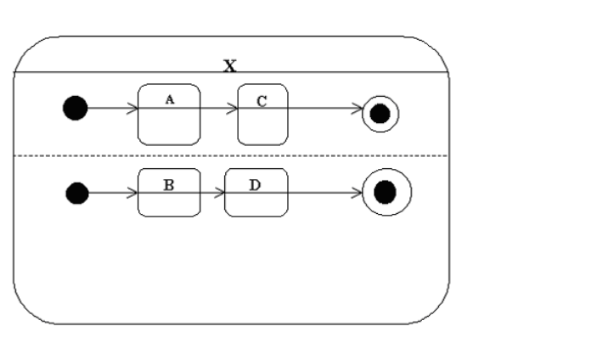
The Synch state

Slide 38
The Synch state
  When state X is entered, substates A and B are also active simultaneously.
  Each concurrent region is independent of the other with each one having its own thread of control.
  Suppose, for the object to enter into substate D, it was necessary that the transitions from substate A from region 1 and substate B of region 2 should have fired.
  Question: How to model circumstances in which the transformation to a substate in one region also depends upon the firing of a transition from a substate in the other region.

Slide 39
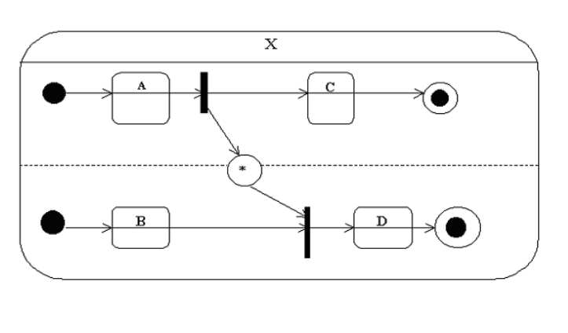
The Synch state

Slide 40
The Synch state
  Use the synch state.
  Connects two concurrent regions that belong to the same composite state.
  Transition from state ‘A’ is given as input to a fork in the first concurrent region.
  Two threads of control emanate from the fork. One is a transition to substate ‘C’ and the other is given as input to the synch state.
  The output of the synch state is given as input to the join in the other concurrent region along with the output from the first substate of that region.

Slide 41
The Synch state
  The output of the join is the transition to the second substate in the second region.
  Suppose transition from A fires which will be an input to the fork.
  The object will also transition to substate C in the first concurrent region.
  However for the object to transition in the second concurrent region to substate D the transition from the join has to fire.
  And transition from join will fire if only the transition from B and the synch state have fired.

Slide 42
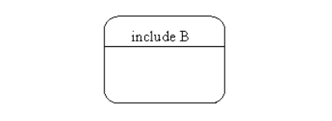
The Submachine reference state

Slide 43
The Submachine reference state
  A given state machine can be referenced from the states of other state machines.
  The state machine which is being referenced is called a submachine and the state of the other state machine which references this particular machine is called as submachine reference state.
  This concept facilitates re-use.
  Suppose a state machine is needed multiple times.
  Instead of drawing it more than once, it can be drawn once and referenced multiple times.
  When it is referenced, its copy is placed in the place of the referenced submachine state.
  A submachine reference state is drawn as an ordinary state with a label
  include submachine-name

Slide 44
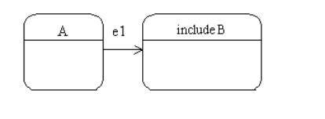
Including the state machine ‘B’

Slide 45
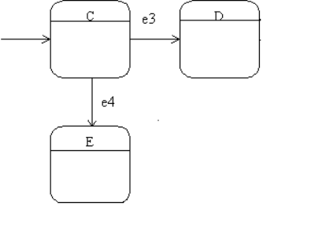
The state-machine B
  The state-machine B

Slide 46
Stub state
  Suppose, in a particular state machine, there is a transition to a submachine reference state.
  So the transition to the initial state of the submachine occurs.
  The occurrence of the event e1 will transition the object from state A to the submachine reference state. i.e. to state C.
  But sometimes when a transition to a submachine reference state occurs, it is desirable to transition to a state other than start state of the target submachine.
  So a stub state is placed within the submachine reference state which identifies a state within the referenced submachine.
  This identified state in the submachine becomes active when a transition to the stub state occurs.

Slide 47
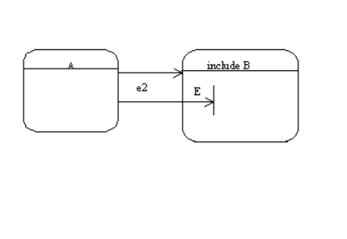
Stub state

Slide 48
Stub state
  Suppose the model is such that on occurrence of the event e2, the transition should be to state E of the submachine B and not to state C.
  A crossbar is placed within the submachine reference state and it is labeled with the state of the submachine (in our case E) to which the transition must occur from state A on the occurrence of event e2.
  The crossbar represents a stub state.
  There may be multiple stub states within the submachine reference state, but connections between any two stub states are prohibited.

Slide 49
Activity Diagrams
  An activity diagram is used to model workflows.
  An activity graph contains activity states.
  Unlike states of an object, activity states do not have to wait for an event to occur to transform to the next activity state.
  The transformation can occur when the activity in the preceding activity state completes.
  The activity diagram has provisions to model activities which can be performed concurrently by different persons in an organization.
  It can also branches to indicate activities to be performed only if certain conditions are fulfilled.

Slide 50
Activity Diagrams
  An activity is a state of doing something.
  It can be a real-world process like the acceptance of an ATM card by an ATM machine.
  It can also be the execution of a software module.
  Activity diagrams considers both the conditional and parallel behaviour.
  The start state is denoted by a filled circle and the end-state by a bull’s eye.
  The activities are denoted by ellipses.

Slide 51
Activity Diagrams
  A branch is denoted by a diamond and it has 1 input and several guarded outputs.
  Out of these outputs, only one can be executed at any one time so they have to be mutually exclusive.
  The else condition can be used when all other conditions fail.
  A merge has many inputs and a single output.
  It ends the conditional behaviour commenced by a branch.
  A fork as 1 input and many outputs each of which occur in parallel.
  The parallel activities commenced by a fork complete at a join.
  The output of a join is executed when all inputs to join have been successfully completed.

Slide 52
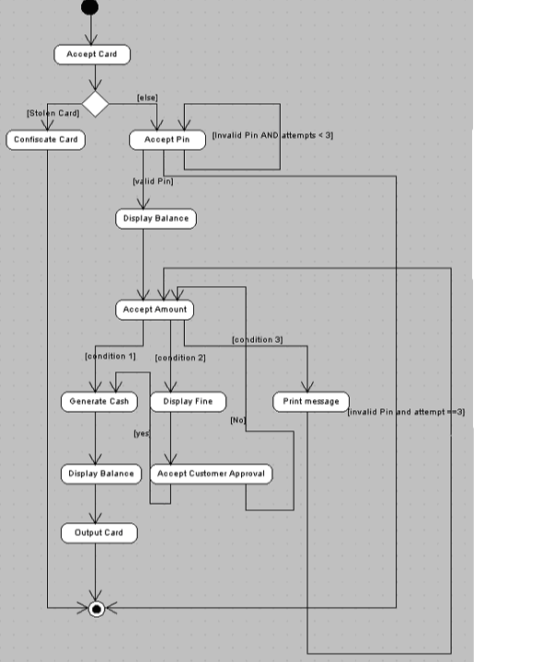

Slide 53
Activity Diagrams
  An activity diagram for the ‘Withdraw Cash’ use case is shown in previous slide. Note that the end of the transaction is shown by a bull’s eye. In this case, it is unnecessary to show a merge as anyway the transaction ends.
  Condition 1 tests whether the customer has entered an amount less than Rs. 500 less than the amount present in the savings account of the customer.
  Condition 2 tests whether the customer has entered an amount not less than Rs. 500 less than the amount present in the savings account of the customer but less than or equal to the amount in the savings account.
  Condition 3 tests whether the customer has entered an amount greater than the amount in his savings account.

Slide 54
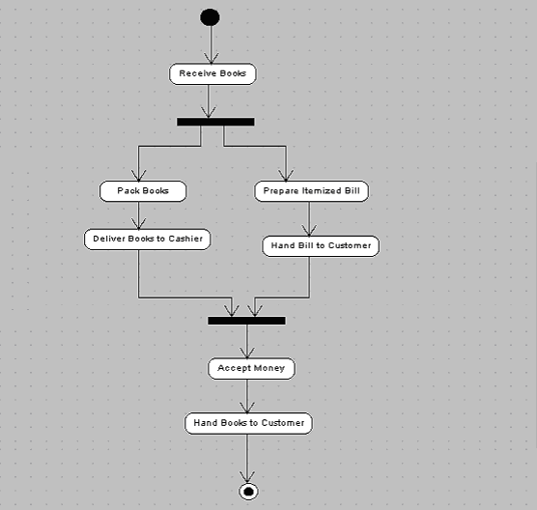
Depicting parallel Activities

Slide 55
Depicting Parallel Activities
  Suppose a customer goes to the local bookshop to buy books. The attendant receives the books selected by me. Now he can
  1)Pack Books, Deliver them to cashier, prepare itemized bill and hand it to the customer OR
  2)Pack Books, Prepare itemized Bill, deliver books to cashier and hand bill to the customer.
  Activities can be done in any order.
  No sequence is imposed.

Slide 56
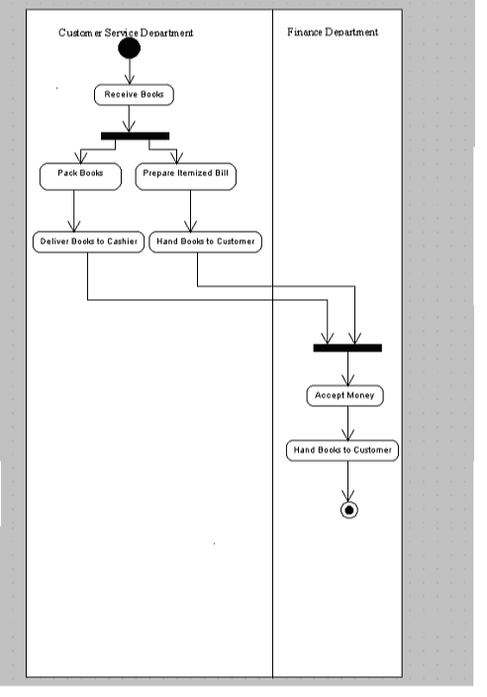

Slide 57
Swimlanes
  In order to make the activity diagram denote “who does what”, it must be arranged into vertical zones, each zone separated by solid lines.
  Each zone can represent the activities of a particular class or department.
  There are 2 departments’ customer service and the Finance.
  The work of accepting selected books, packing them, calculating the bill, giving the bill to the customer and the packed books to the cashier is done by the customer service department
  Actual acceptance of the cash and handing over the purchase to the customer is done by the finance department.

Slide 58
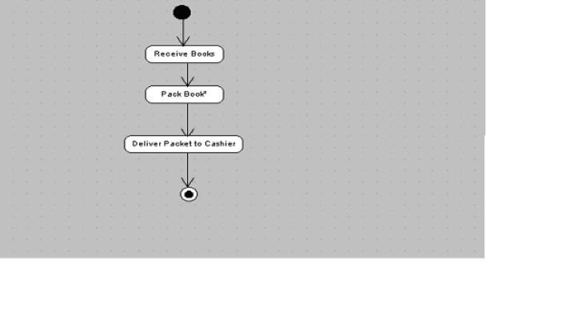
Dynamic Concurrency

Slide 59
Dynamic Concurrency
  It is possible to show iterations without constructing a loop.
  The customer will hand the books selected by him to the attendant for packing.
  The attendant will put each book in the packet till all books chosen by the customer are put inside.
  This is indicated by placing an asterisk beside the "Pack Book" activity.
  In other words, for each book, the activity "Pack Book" is carried out.

Slide 60
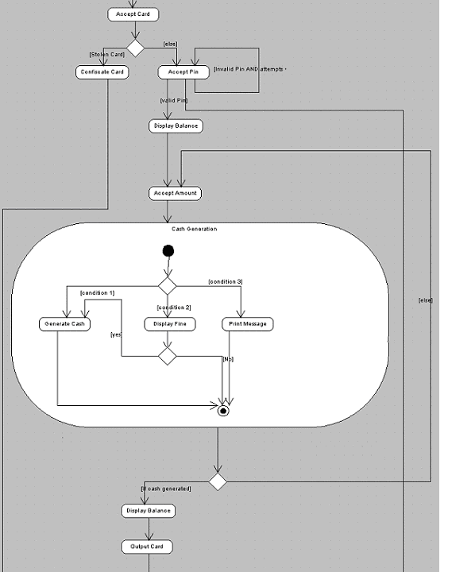

Slide 61
Decomposing an Activity
  Only the main activity can be shown in the parent diagram and the sub-activities separately or the super-activity with the sub-activities inside it as shown in previous slide

